Slide 1
ECOLOGY
The study of living organisms in the natural environment
How they interact with one another
How the interact with their nonliving environment
© 2016 Paul Billiet ODWS

Slide 2
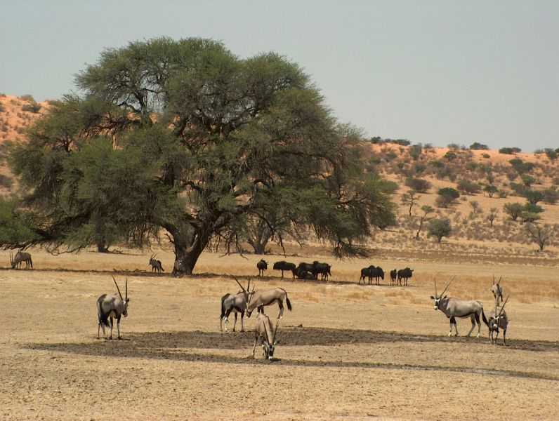
Ecosystem
Community + Abiotic environment, interacting
© 2016 Paul Billiet ODWS
www.nissan4x4.co.za/Gallery/Bongani/Kgalagadi...

Slide 3
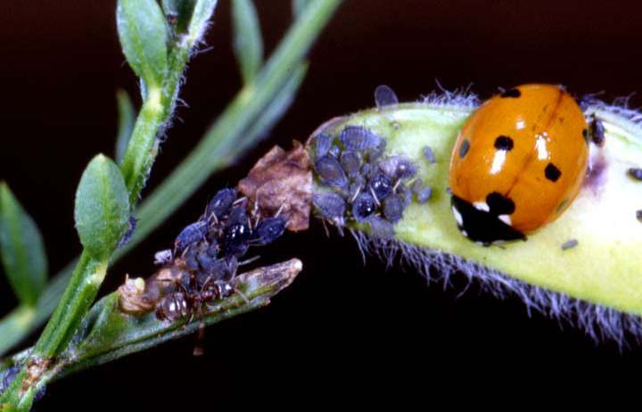
Community
All the populations of the different species living and inter-acting in the same ecosystem
7-spotted lady bird
(Adephagia septempunctata)
Bean aphids
(Aphis fabae)
Red ant (Myrmica rubra) and
Broom plant
(Cytisus scoparius)
© 2016 Paul Billiet ODWS
© P Billiet

Slide 4
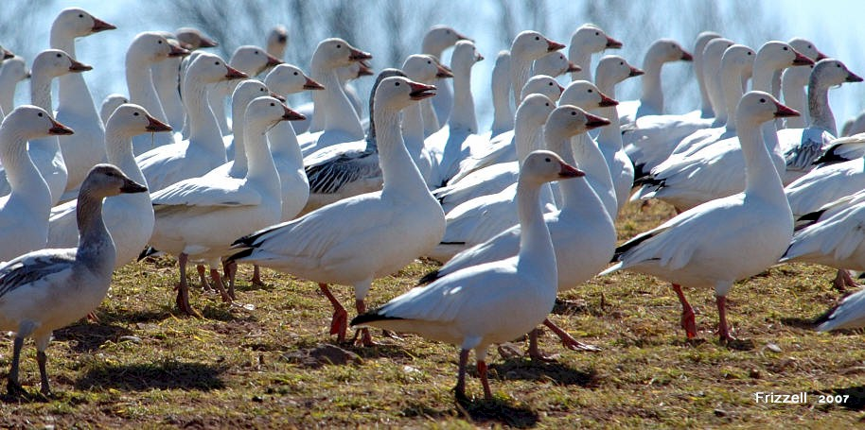
Species
A group of organisms that can breed to produce fully fertile offspring
Snow geese (Chen caerulescens)
jim-frizzell.com/.../2007-03-06_snow-goose-4.jpg
© 2016 Paul Billiet ODWS

Slide 5
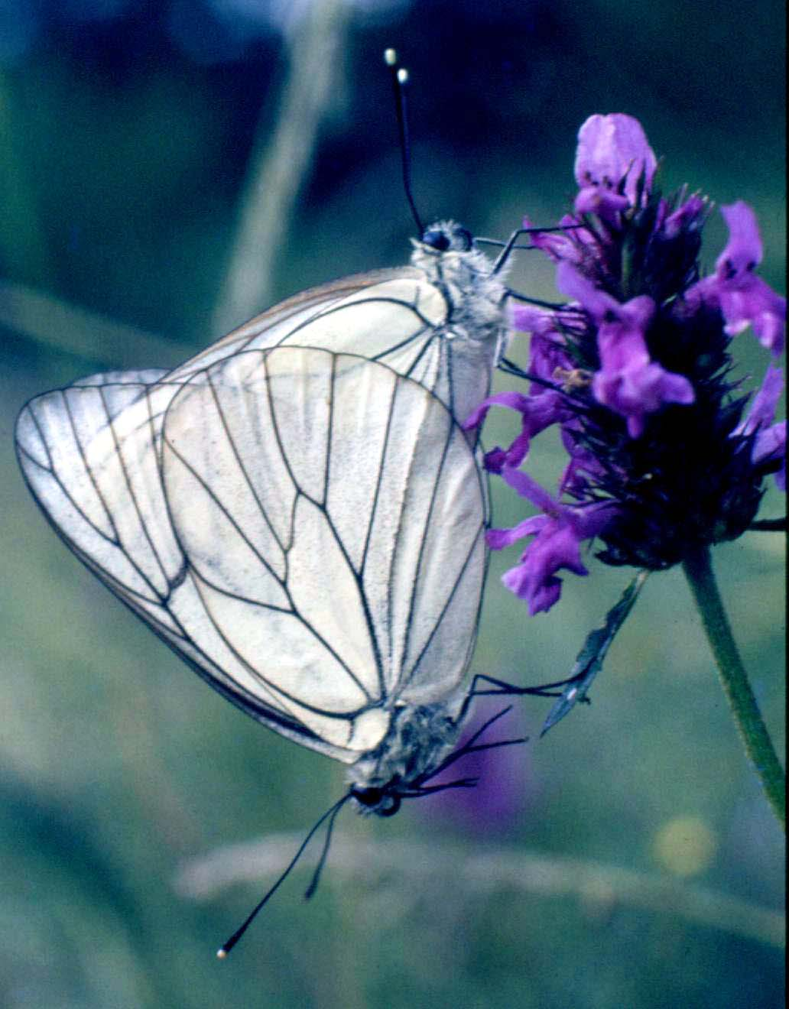
Population
A group of organism of the same species which live in the same habitat at the same time where they can freely interbreed
The black-veined white butterfly
(Aporia crataegi) mating
© 2016 Paul Billiet ODWS
© P Billiet

Slide 6
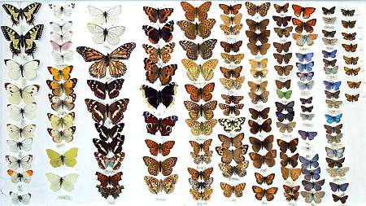
Biodiversity
The total number of different species in an ecosystem and their relative abundance
© 2016 Paul Billiet ODWS
www.worcestercitymuseums.org.uk/.../bbox2.jpg

Slide 7
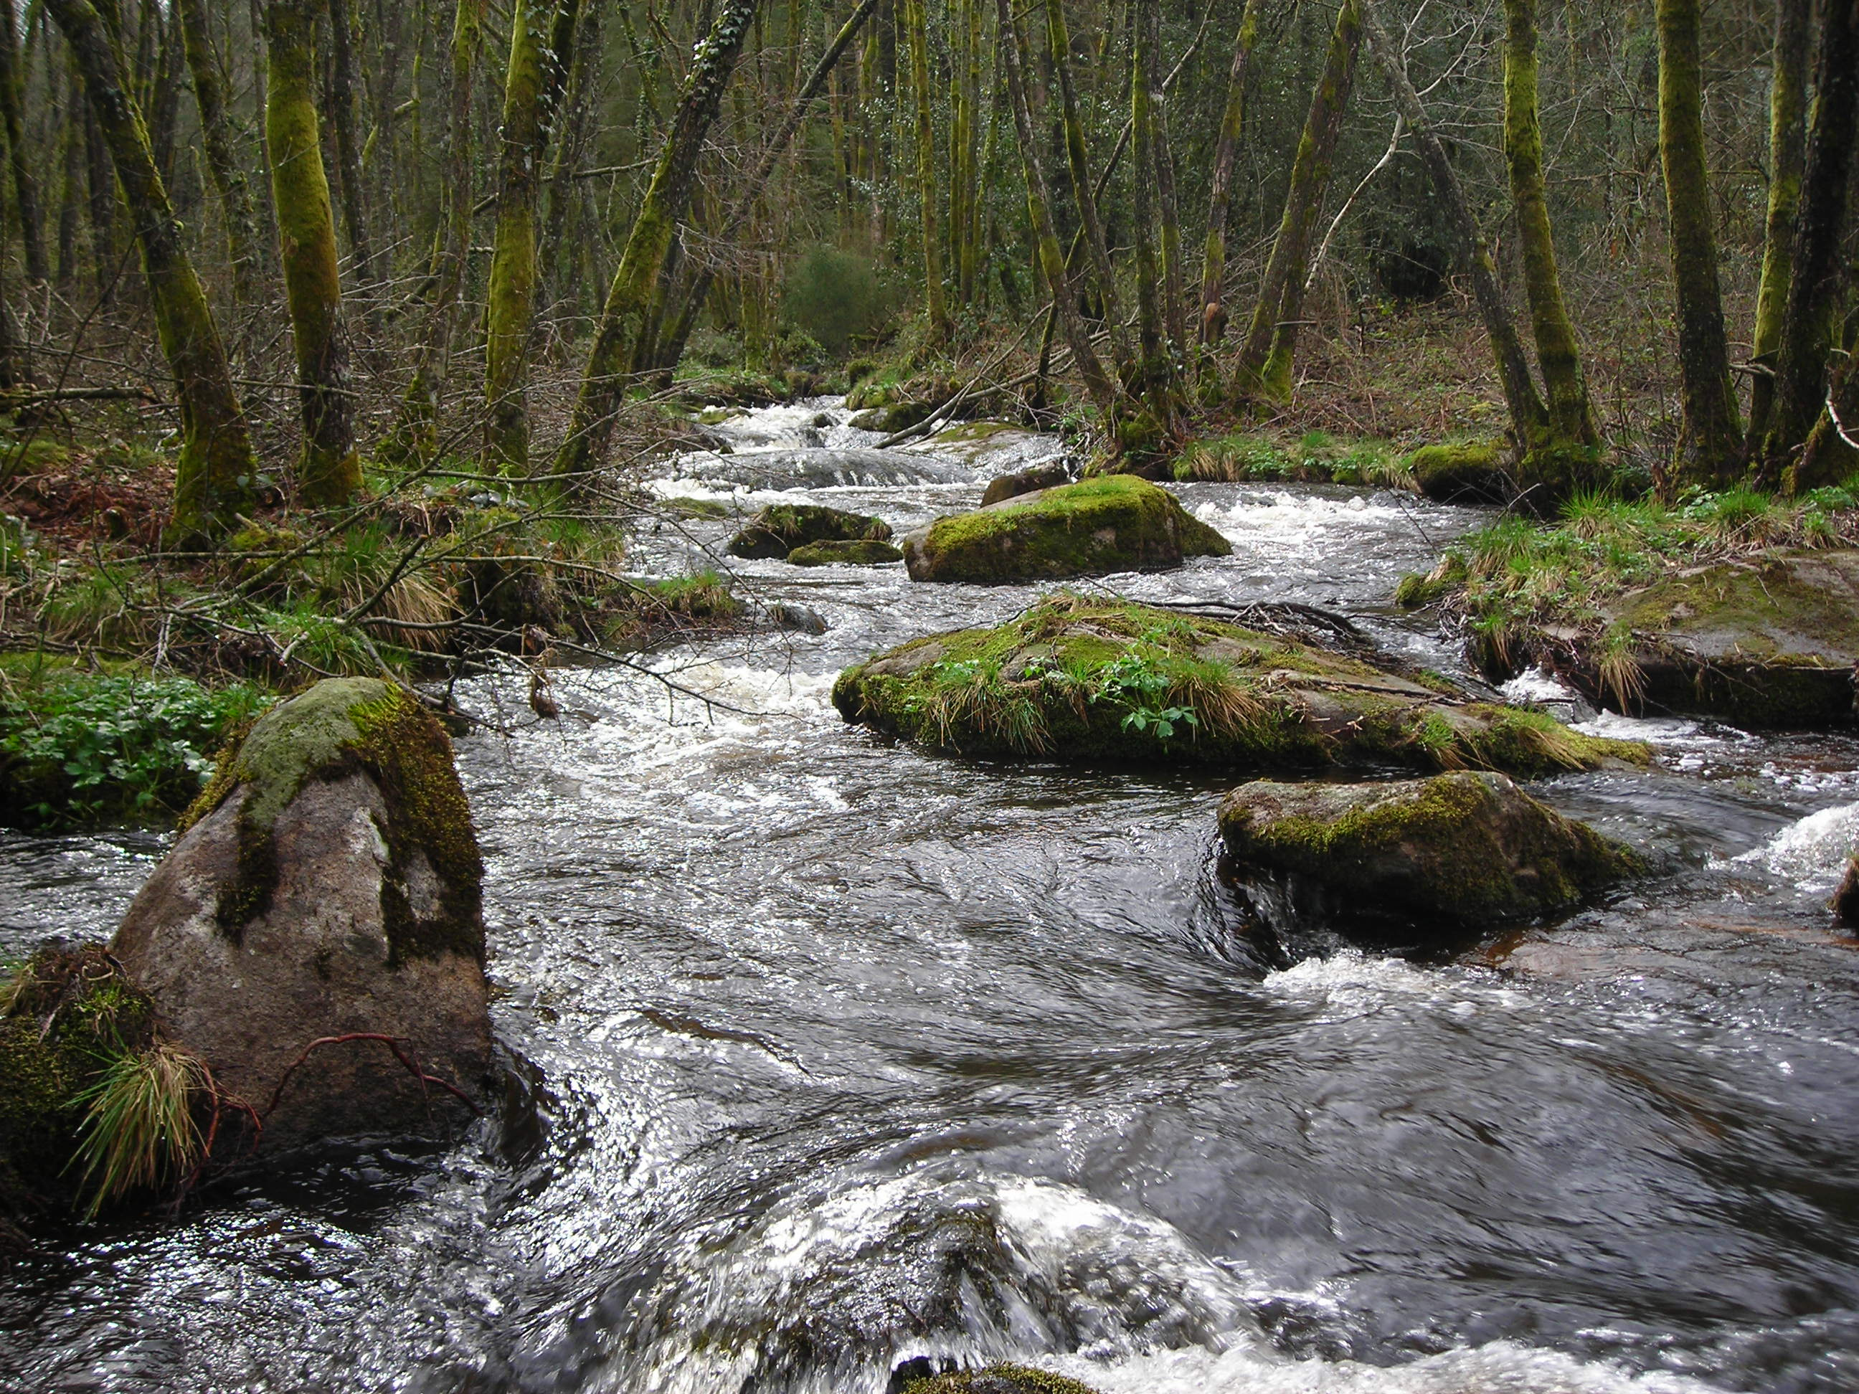
Habitat
The characteristics of the type of environment where an organism normally lives.
(e.g. a stoney stream, a deciduous temperate woodland, Bavarian beer mats)
© 2016 Paul Billiet ODWS
© P Billiet

Slide 8
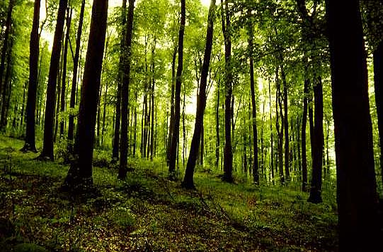
Energy and organisms
Autotrophs
© P Billiet
Organisms which can synthesise their own complex, energy rich, organic molecules from simple inorganic molecules (e.g. green plants synthesis sugars from CO₂ and H₂O)
© 2016 Paul Billiet ODWS

Slide 9
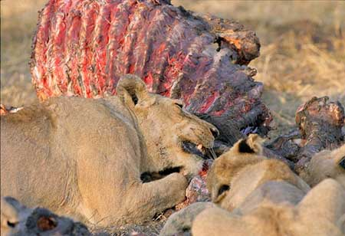
Heterotrophs
Organisms who must obtain complex, energy rich, organic compounds form the bodies of other organisms (dead or alive)
© 2016 Paul Billiet ODWS
http://www.kruger2canyons.com/

Slide 10
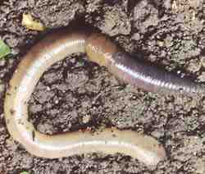
Detritivores
Heterotrophic organisms who ingest dead organic matter. (e.g. earthworms, woodlice, millipedes)
Earth worm
(Lumbricus terrestris)
© 2016 Paul Billiet ODWS
www.columbia.edu/.../worm_lumbricus.jpg

Slide 11
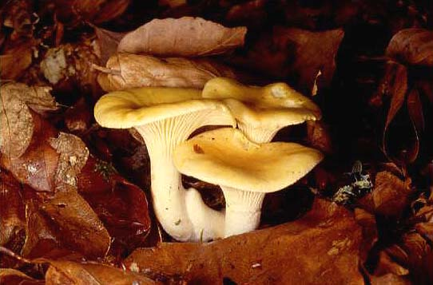
Saprotrophs
Heterotrophic organisms who secrete digestive enzymes onto dead organism matter and absorb the digested material. (e.g. fungi, bacteria)
Chanterelle
(Cantherellus cibarius)
© P Billiet
© 2016 Paul Billiet ODWS

Slide 12
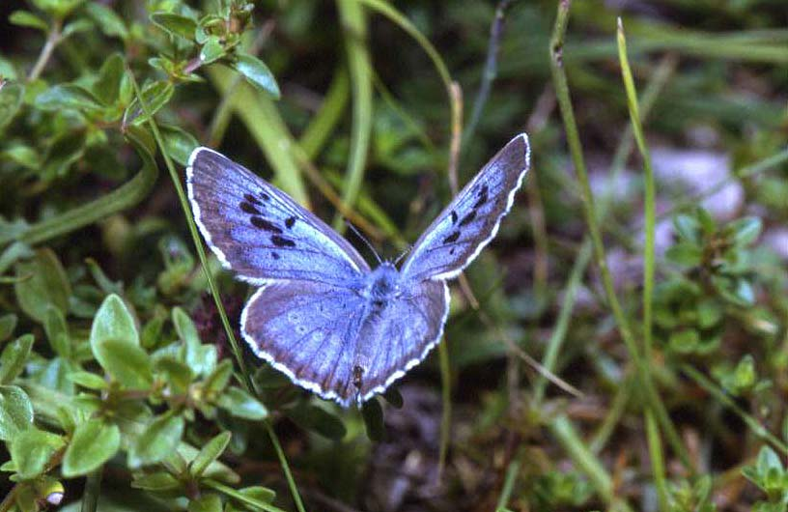
Feeding relationships
Predators & prey
Herbivory
Parasite & host
Mutualism
Competition
Large blue butterfly
(Maculinea arion)
© P Billiet
© 2016 Paul Billiet ODWS

Slide 13
The place of an organism in its environment
Niche
An organism’s habitat + role + tolerance limits to all limiting factors
The niche of a species therefore consists of:
Its role in the ecosystem (herbivore, carnivore, producer etc)
Its tolerance limits (e.g. soil pH, humidity)
Its requirements for shelter, nesting sites etc etc, all varying through time
© 2016 Paul Billiet ODWS

Slide 14
Fundamental niche
An organism can maintain a viable population within the conditions that define it’s niche = fundamental niche
In an ideal world wherever we find the right conditions we should find always a particular species...
but we don’t always find a species where it should exist
© 2016 Paul Billiet ODWS

Slide 15
Realised niche
What factors stop a species from fully exploiting its niche?
The powers of colonisation of the species
Remote sites may not be colonised
Other species may stop it from developing to its full potential
Competitors (see competitive exclusion)
Predators
© 2016 Paul Billiet ODWS

Slide 16
Aliens
Alien species are a good example of species that occupy more of their niche than in their native habitats
In their native habitats competitors and predators limit their niche
© 2016 Paul Billiet ODWS

Slide 17
THE COMPETITIVE EXCLUSION PRINCIPLE
G.F. Gause (1934)
If two species, with the same niche, coexist in the same ecosystem, then one will be excluded from the community due to intense competition
© 2016 Paul Billiet ODWS

Slide 18
The niche as a two-dimensional shape
Species A
Niche represented by a 2-dimensional area
© 2016 Paul Billiet ODWS

Slide 19
Separate niches
Species A
Species B
No overlap of niches.
So coexistence is possible
© 2016 Paul Billiet ODWS

Slide 20
Overlapping niches
Species B
Species C
Interspecific competition occurs where the niches overlap
© 2016 Paul Billiet ODWS

Slide 21
The ghost of competition past!
Species B
Species C
Evolution by natural selection towards separate niches
Species B’
Species C’
Specialisation into two separate niches
© 2016 Paul Billiet ODWS

Slide 22
This niche is not big enough for the both of us!
Species A Species D
Very heavy competition leads to competitive exclusion
One species must go
© 2016 Paul Billiet ODWS

Slide 23
Total exclusion
Species A has a bigger niche it is more generalist
Species E has a smaller niche it is more specialist
Specialists, however, do tend to avoid competition
Here it is totally swamped by Species A
© 2016 Paul Billiet ODWS

Slide 24
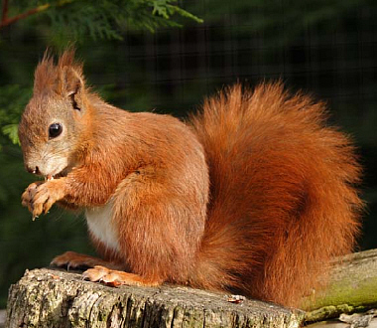
Example: Squirrels in Britain
The Red Squirrel (Sciurus vulgaris) is native to Britain
Its population has declined due to:
Competitive exclusion
Disease
Disappearance of hazel coppices and mature conifer forests in lowland Britain
www.isleofwighttouristguide.com/Articles/red.jpg
© 2016 Paul Billiet ODWS

Slide 25
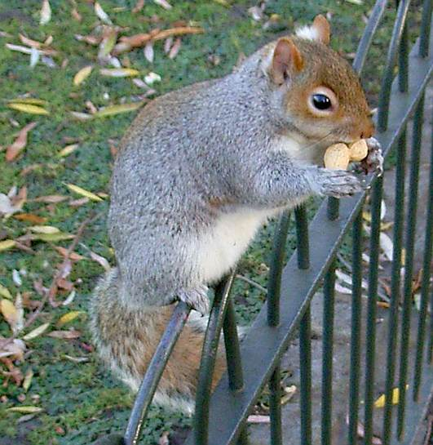
The Alien
The Grey Squirrel (Sciurus carolinensis)
is an alien species
Introduced to Britain in about 30 sites between 1876 and 1929
It has easily adapted to parks and gardens replacing the red squirrel
www.shoarns.com/Grey%20Squirrel%202.jpg
© 2016 Paul Billiet ODWS

Slide 26
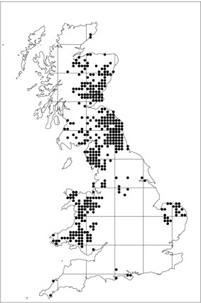
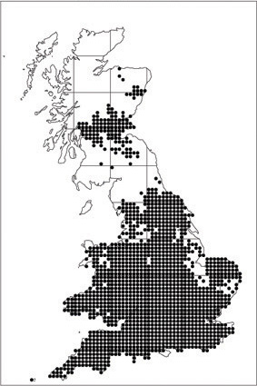
Today’s distribution
Red squirrel
Grey squirrel
Maps prepared by the Biological Records Centre, CEH Monks Wood, from records collated by the Mammal Society and others mainly between 1965 and 1993, also including earlier, published records and a few additions up to 1997. The maps were drawn using Dr Alan Morton's DMAP software
© 2016 Paul Billiet ODWS

